Slide 1
Mehran S. Fallah April 2020
Programming Languages
Session II
Syntax

Slide 2
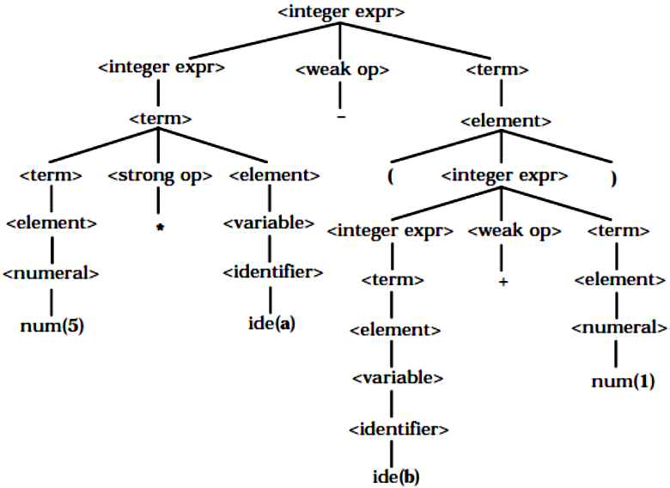
Concrete vs. Abstract Syntax (Ctd.)

Slide 3
Abstract Syntax
The point of abstract syntax is simply to communicate the structure of phrases in terms of their semantics in a programming language as trees.
Semantics can be defined in terms of derivation trees, and actually with attribute grammars, but most semantic methods are far more understandable when based on a cleaner representation of the phrases in a language.
Abstract syntax trees are specified by a set of (abstract) syntactic categories and a set of rules that tell how categories are decomposed into other categories.
To design the abstract syntax of a programming language we should determine which notions (nonterminals) are fundamental to the language and which basic forms the constructs of the language may take.
For example, by observing the concrete syntax for Wren, we see that expressions (the nonterminal <expr>) ultimately consist of operations (+, -, and, not, and so on) applied to numerals, identifiers, and Boolean constants (true and false). Therefore, we reduce the nonterminals used to define expressions intro three abstract syntactic categories: Expression, Numeral, and Identifier.
We fold the categories of terms, elements, and comparisons into Expression since they are simply special cases of expressions

Slide 4
Abstract Syntax (Ctd.)
To find the abstract productions that specify the basic patterns of expressions, we first repeat those BNF rules that define expressions in Wren, but with the nonterminals <weak op>, <strong op>, <relation>, and <variable> factored out.

Slide 5

Abstract Syntax (Ctd.)
Consider the derivation
<expr> $⇒$ <integer expr> $⇒$ <term> $⇒$ <element> $⇒$ <numeral>.
The only essential information relative to Wren is that an expression can be a numeral. Therefore unit rules such as <integer expr> ::= <term> can be ignored unless they involve basic components of expressions, such as numerals, identifiers, or essential nonterminals. Omitting parenthesized expressions, the following list results:
After the redundant nonterminals are merged into Expression, these basic templates can be summarized by the following abstract production rules:

Slide 6
Abstract Syntax for Wren

Slide 7
Abstract Syntax for Wren (Ctd.)
An alternative abstract syntax for Wren:
abstract
concrete

Slide 8
Scan and Parse: Revisited
A Sequence of Tokens
Abstract Syntax Tree
Program as Text
(A Sequence of Characters)
Lexical Analyzer
(Scanner)
Syntactic Analyzer
(Parser)
Lexical Syntax
Phrase-Structure Syntax (BNF)
and
Abstract Syntax

Slide 9
Formal Syntax and Semantics by Kenneth Slonneger and Barry Kurtz
You may begin doing exercises of Chapter 1.

